Slide 1


PARK COLLEGE OF ENGINEERING AND TECHNOLOGY
Kaniyur, Coimbatore - 641659
Department of Computer Science & Enginerring
Strengthening Defenses with Data Analytics against Malicious Links
Internal Guide
Team Members
Mrs.S.Princy , M.E. Assistant Professor CSE
Gopala Krishna.J - 712220104016
Santhosh Kumar.M Visagan.P
- 712220104023
- 712220104048
Vishram.R - 712220104053

Slide 2

OUTLINE
Introduction
Problem Statement
Objective
Abstract
Literature Review
Inference from Literature Review
Existing System
Drawbacks
Architectural Diagram
Proposed System
Advantages
Modules
In-build Algorithms
Screenshots
Summary
References

Slide 3
INTRODUCTION
In today's interconnected digital world, the internet serves as a crucial platform for communication, commerce, and information exchange. However, alongside its myriad benefits, the internet also harbors various threats, one of the most pervasive being malicious URLs
This Malicious Uniform Resource Locators (URLs) are designed with harmful intent, ranging from phishing scams to malware distribution, posing significant risks to user’s privacy, security, and digital assets.
The need for robust mechanisms to detect and mitigate these malicious URLs is paramount. Traditional methods of URL analysis and identification often fall short in keeping pace with the evolving tactics of cybercriminals
As a result, there is a growing imperative to leverage advanced technologies such as data analytics to enhance the detection capabilities and efficiency of combating malicious URLs.

Slide 4
PROBLEM STATEMENT
Develop a data analytics framework to accurately identify and classify malicious URLs in real-time.
Enhance URL security by leveraging data analytics techniques for proactive detection of malicious URLs
Investigate the effectiveness of machine learning algorithms in detecting and mitigating the threat posed by malicious URLs.
Design and implement a scalable solution for automated detection of malicious URLs using advanced data analytics.
Explore novel approaches in data analytics to address the challenge of identifying and preventing the dissemination of harmful URLs across digital platforms.

Slide 5
OBJECTIVES
Detecting malicious URLs using data analytics represents a critical frontier in cybersecurity. By leveraging advanced analytical techniques and Machine Learning Algorithm.
This project aims to:
Employ Machine Learning algorithm, such as LSTM and XGBoost for accurate classification of malicious URLs.
Conduct rigorous data collection and preprocessing to extract relevant features and enhance detection capabilities.
Optimize model performance through experimentation with different algorithms and feature combinations.
Establish mechanisms for continuous monitoring and updating of the detection system to address emerging threats effectively.

Slide 6
ABSTRACT
In the ever-evolving landscape of cybersecurity, the detection of malicious URLs remains a critical challenge. This study presents an innovative approach to effectively identify malicious URLs. By leveraging advanced techniques, we demonstrate a robust method for accurately detecting malicious URLs while minimizing false positives. Our findings underscore the importance of continually refining and adapting detection methods to counter emerging cyber threats effectively. Amidst the escalating sophistication of cyber threats, the identification of malicious URLs stands as a pivotal task in fortifying digital security. This research unveils a progressive methodology tailored to discern and mitigate the risks posed by malicious URLs. Through a comprehensive exploration of innovative techniques, our approach exhibits a formidable capacity to detect malicious URLs with precision, bolstering defense mechanisms against cyber intrusions. The study underscores the imperative of continual refinement and adaptation in cybersecurity practices to stay ahead of evolving threats, ensuring the resilience of digital infrastructures in an ever-changing landscape of risk.

Slide 7
LITERATURE SURVEY
TITLE | AUTHOR &YEAR | METHOD
Malicious URL prediction based on community detection | : Zheng Li-xiong, Xu Xiao-lin, Li Jia, Zhang Lu and Pan Xuan-chen 2020 | Graph-based Method
Detecting malicious URLs using machine learning techniques | Frank Vanhoenshoven, Gonzalo Nápoles, Rafael Falcon. 2016 | Support Vector Machine
Detecting Malware, Malicious URLs and Virus Using Machine Learning and Signature Matching | Jatin Acharya, Anshul Chaudhary, Anish Chhabria 2019 | Random Forest Model
A Comparative Analysis of Machine Learning Algorithms on Malicious URL Prediction. | Tianlong Liu, Yu Qi, Liang Shi and Jianan Yan. 2019 | Logistic Regression
Detecting Malicious URLs Using Machine Learning Techniques Review and Research Directions | Mohan Li, Yanbin Sun; Hui Lu, and Sabita Maharjan 2022 | Gradient Boosting Machine

Slide 8
EXISTING SYSTEM
Integration of feature extraction and machine learning enables automated detection of malicious URLs.
Integration of feature extraction and machine learning enable Continuous monitoring ensures adaptability to evolving threats in real-time.es automated detection of malicious URLs.
Utilization of diverse machine learning algorithms enhances accuracy and robustness of detection.
Evaluation metrics such as precision and recall gauge the effectiveness of the system in mitigating security risks.

Slide 9
DRAWBACKS
Limited effectiveness against sophisticated attacks employing URL obfuscation or evasion techniques.
Vulnerable to adversarial attacks aiming to manipulate features and evade detection.
Dependency on labeled datasets may hinder scalability and generalization to new, unseen threats.
Resource-intensive preprocessing and model training stages may impact real-time performance and scalability.

Slide 10
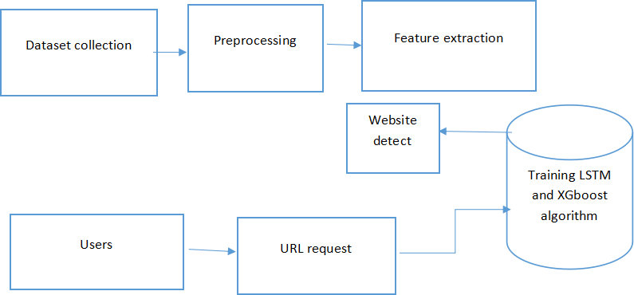
ARCHITECTURE DIAGRAM

Slide 11
PROPOSED SYSTEM
LSTM is effective for capturing sequential patterns in data, making it suitable for analyzing URL structures and identifying patterns indicative of malicious intent.
Enhancing the extracted features with additional relevant information such as domain age, presence of suspicious keywords, URL length, and use of special characters. These engineered features provide valuable contextual information for the classification task..
Combination of LSTM-extracted features with features generated by XGBoost, a powerful gradient boosting algorithm known for its robustness and efficiency in handling structured data. XGBoost can complement LSTM by capturing nonlinear relationships and interactions between features.
Evaluate the performance of the combined LSTM-XGBoost model using appropriate metrics such as accuracy, precision, recall, and F1-score. Fine-tune hyperparameters of both algorithms through cross-validation to optimize model performance and generalization ability.

Slide 12
ADVANTAGES
By combining LSTM and XGBoost, the system can effectively capture complex relationships and interactions within the URL data, enhancing detection accuracy.Scalable solution capable of processing large volumes of URL data efficiently.
Both LSTM and XGBoost are robust to imbalanced data and can effectively handle skewed class distributions, resulting in more reliable detection performance.
LSTM captures sequential patterns, while XGBoost enhances feature representation and captures complex relationships. By combining these models, the system achieves higher detection accuracy and robustness than either model alone.
The system can adapt to evolving threats by continuously learning from new data. LSTM and XGBoost can be updated with the latest information to stay ahead of emerging malicious URL patterns, ensuring ongoing effectiveness in detecting threats.

Slide 13



MODULES
Module 1: Data Collection
The system can collect data from various sources, such as Websites,Online surveys forms, and other sources.
Module 2 : Feature Extraction:
Extracts relevant features from URLs, such as domain length, presence of suspicious keywords, and lexical analysis of the URL string.
Module 3 : Data Preprocessing:*
Cleans and preprocesses the extracted features to prepare them for model training.

Slide 14


MODULES
Module 4 : Model Training:
Utilizes LSTM (Long Short-Term Memory) to capture sequential patterns in URLs. - Utilizes XGBoost (Extreme Gradient Boosting) to analyze URL features and make predictions.
Module 5 : Ensemble Learning:
Combines predictions from LSTM and XGBoost models to improve overall detection accuracy.

Slide 15
ALGORITHM
LSTM(Long-short Term Memory) :
LSTM (Long Short-Term Memory) is a type of recurrent neural network (RNN) commonly used in malicious URL detection.
It excels at capturing sequential patterns in URL sequences, allowing it to analyze the structural complexities of URLs and identify patterns indicative of malicious intent.
By leveraging LSTM, the system can extract meaningful features from URL data, enabling accurate detection of malicious URLs even in the presence of subtle variations and obfuscation techniques.
XGBoost(Extreme Gradient Boosting)
XGBoost (Extreme Gradient Boosting) is a powerful machine learning algorithm widely used in malicious URL detection. It's an ensemble learning method that builds a strong predictive model by combining the predictions of multiple weak learners, typically decision trees.
XGBoost excels in detecting patterns and relationships within URL data, making it effective in distinguishing between malicious and benign URLs.
It iteratively improves prediction accuracy by minimizing a specified loss function, employing techniques like gradient boosting and regularization to prevent overfitting.
With its robustness and ability to handle large datasets, XGBoost is a popular choice for detecting malicious URLs with high accuracy and efficiency.

Slide 16
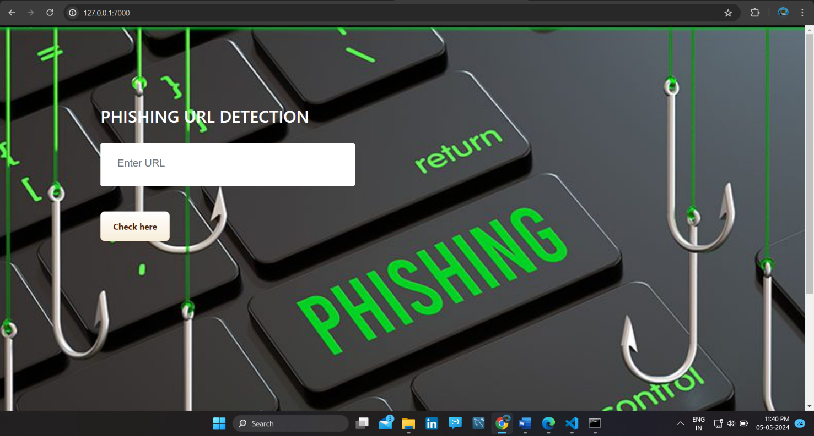
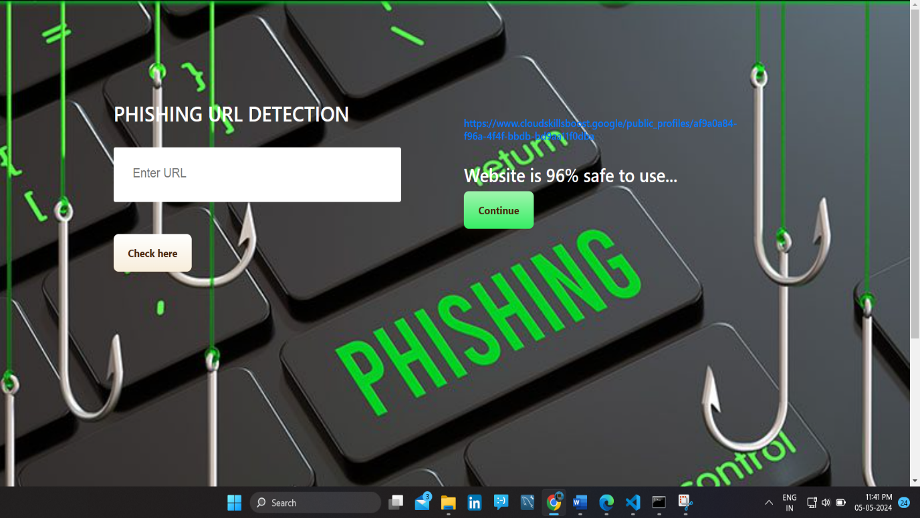
SCREENSHOTS
Home Screen
Output Screen

Slide 17
SUMMARY
"Detecting Malicious URLs using Data Analytics" employs advanced techniques like feature extraction, machine learning, and continuous monitoring to identify threats in real-time, bolstering cybersecurity defenses.
This approach offers scalability to handle large datasets efficiently, adaptability to evolving threats, and automation for swift response, ensuring robust protection against the dynamic landscape of malicious URL activity.
By integrating analytics-driven detection methods, organizations can proactively safeguard their systems and users from potential security breaches, bolstering overall cybersecurity posture in an increasingly digitized world..

Slide 18
REFERENCES
K. Saranya; K. Varunvikash; K. Karthikeyan; S. Rosanakthar, "Detecting Malicious URLs using Data Analytics“, International Conference on Sustainable Computing and Smart Systems, June 2023.
Upendra Shetty D R; Anusha Patil; Mohana, "Malicious URL Detection and Classification Analysis using Machine Learning Models", International Conference on Intelligent Data Communication Technologies and Internet of Things (IDCIoT), January 2023.
Yu-Chen Chen; Yi-Wei Ma; Jiann-Liang Chen, "Intelligent Malicious URL Detection with Feature Analysis", IEEE Symposium on Computers and Communications, July 2020

Slide 19
REFERENCES
Chiyu Ding "Automatic Detection of Malicious URLs using Fine-Tuned Classification Model", 5th International Conference on Information Science, Computer Technology and Transportation (ISCTT), March 2021.

Slide 20
THANK YOU

